Slide 1



Trees
swatimali@somaiya.edu

Slide 2
Outline
Tree – concept
General tree
Types of trees
Binary tree: representation, operation
Binary tree traversal
Binary search tree
BST- The data structure and implementation
Threaded binary trees.
Search Trees –
AVL tree, Multiway Search Tree, B Tree, B+ Tree, and Trie,
Applications/Case study of trees.
Summary
Queries?

Slide 3
Tree
linear data structures – strings, arrays, lists, stacks and queues
Non-linear data structure - tree.
Mainly used to represent data containing a hierarchical relationship between elements, for example, records, family trees and table of contents.
E.g. a parent-child relationship

Slide 4
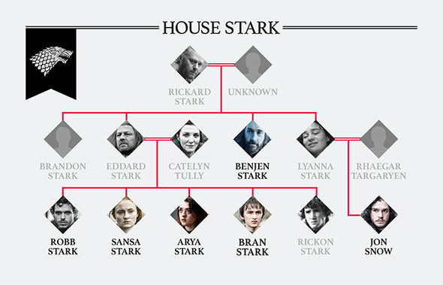
A family tree

Slide 5
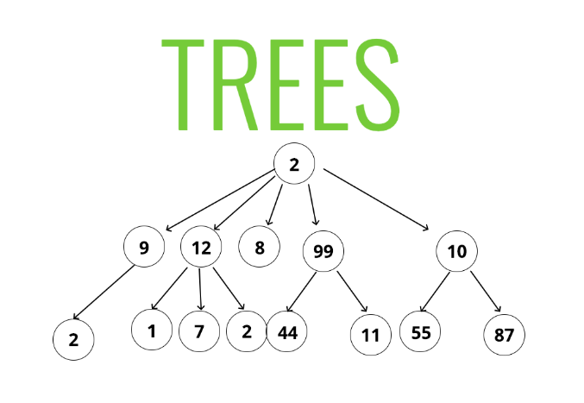
A Tree

Slide 6
Types of trees
General tree
Binary tree
Binary search tree
Threaded binary tree
AVL Tree
B tree
B+ Tree
Trie
Heap
Red black tree
Splay tree

Slide 7
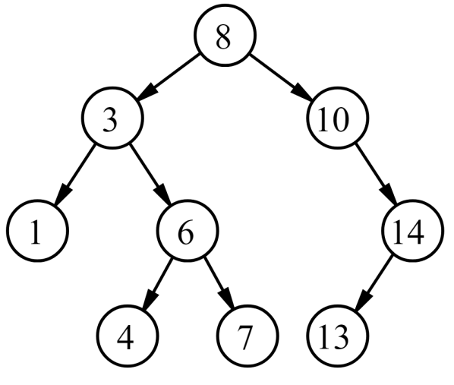
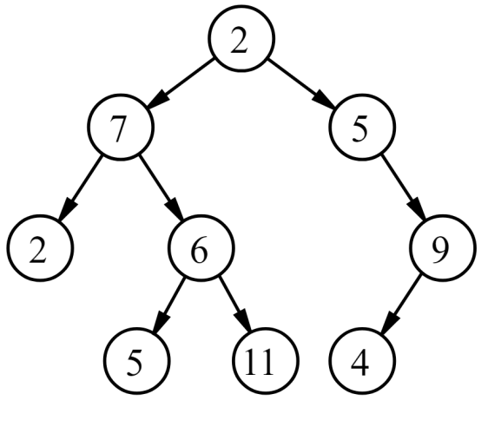
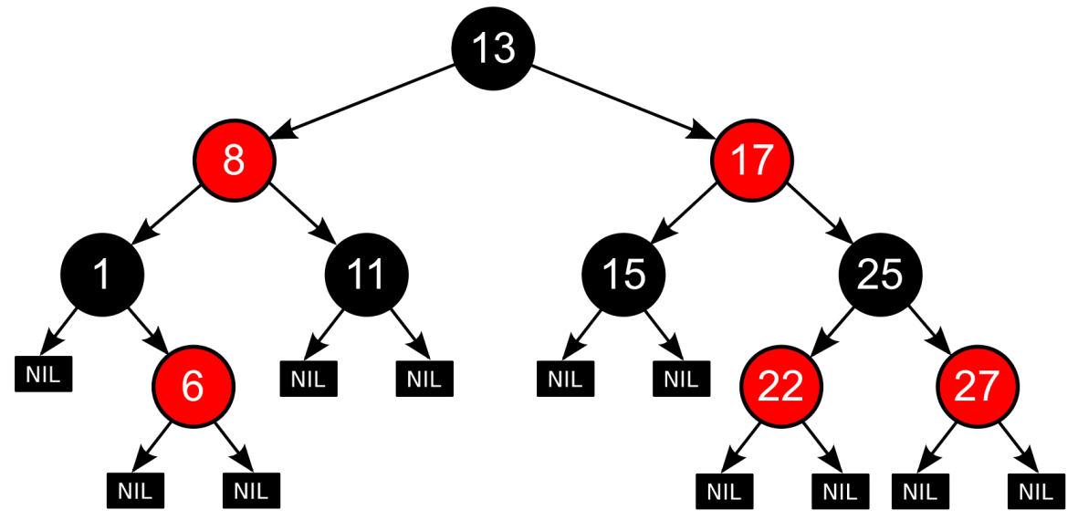
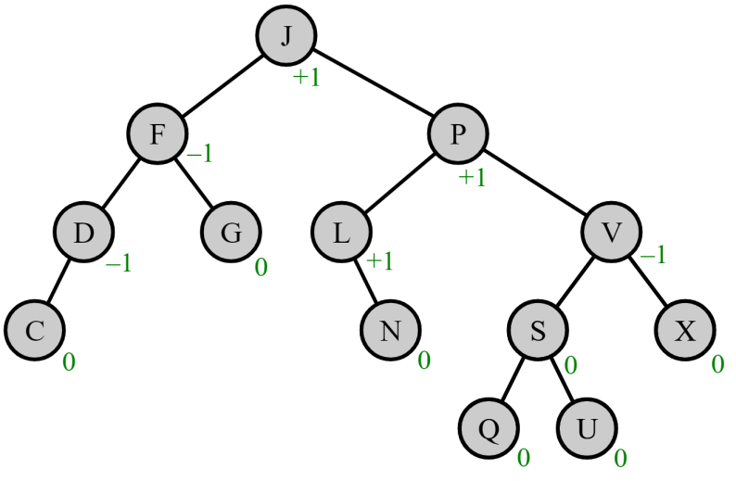
Binary Tree
Binary search Tree
Red Black Tree
AVL Tree

Slide 8
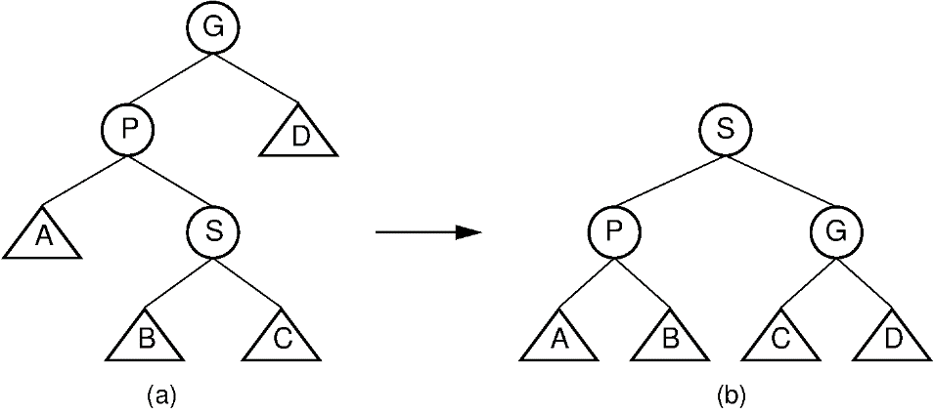
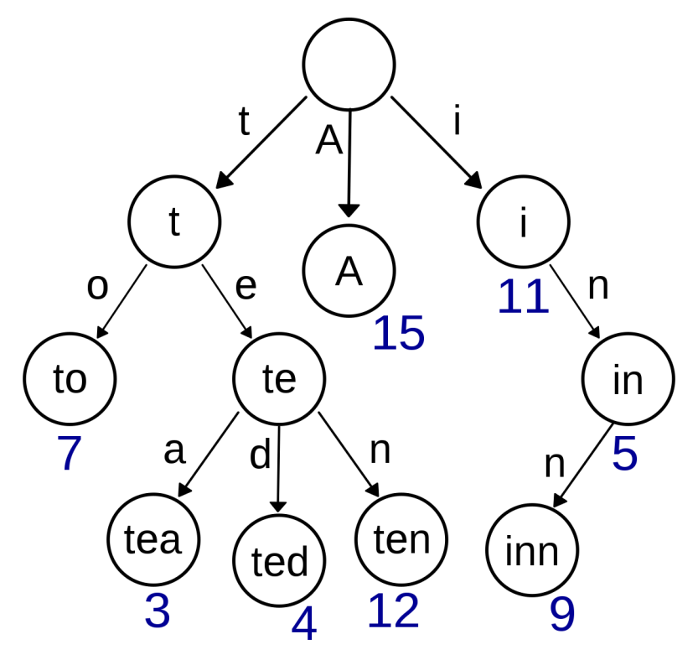
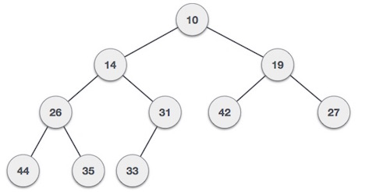
Splay Tree
Trie
Heap (MinHeap)

Slide 9
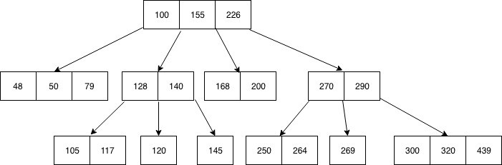
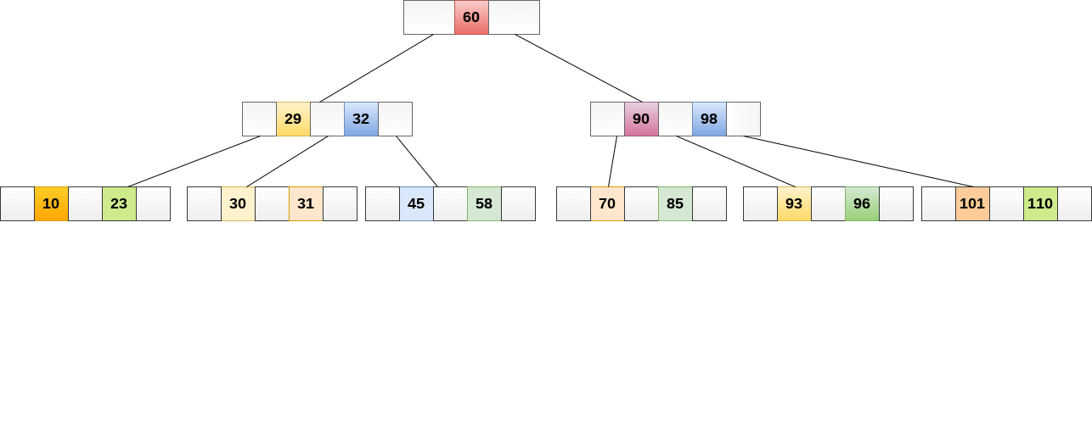
B Tree
B+ Tree

Slide 10
Tree Data structure
A tree is an abstract model of a hierarchical structure that consists of nodes with a parent-child relationship.
Tree is a sequence of nodes
There is a starting node known as a root node
Every node other than the root has a parent node.
Nodes may have any number of children

Slide 11
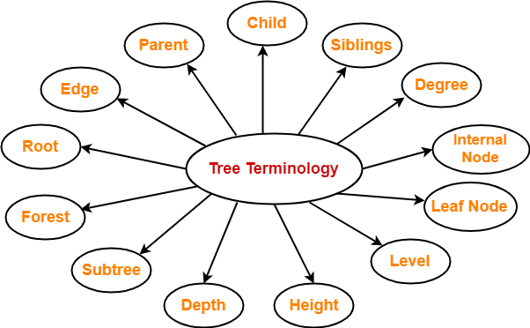

Slide 12
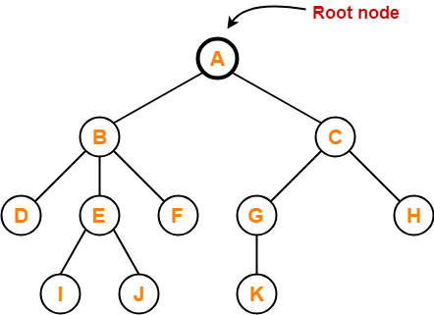
1. Root
The first node from where the tree originates is called as a root node.
In any tree, there must be only one root node.
We can never have multiple root nodes in a tree data structure.

Slide 13
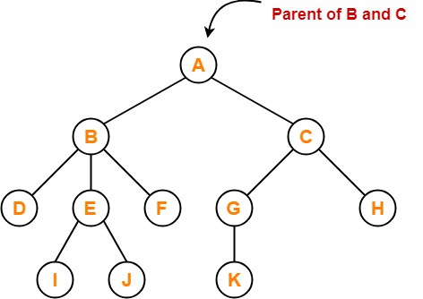
2. Edge
The connecting link between any two nodes is called as an edge.
In a tree with n number of nodes, there are exactly (n-1) number of edges.

Slide 14
3. Parent
The node which has a branch from it to any other node is called as a parent node.
In other words, the node which has one or more children is called as a parent node.
In a tree, a parent node can have any number of child nodes.

Slide 15
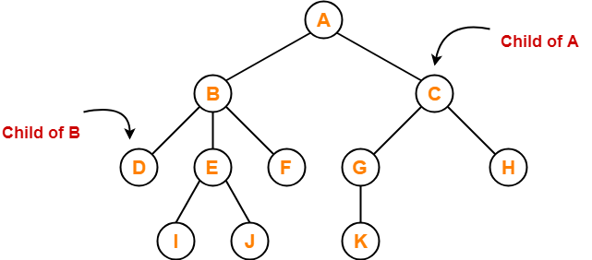
4. Child
The node which is a descendant of some node is called as a child node.
All the nodes except root node are child nodes.

Slide 16
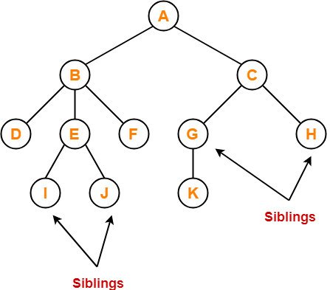
5. Siblings
Nodes which belong to the same parent are called as siblings.
In other words, nodes with the same parent are sibling nodes.

Slide 17
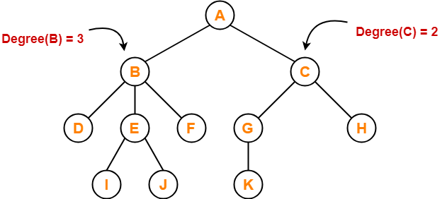
6. Degree
Degree of a node is the total number of children of that node.
Degree of a tree is the highest degree of a node among all the nodes in the tree.

Slide 18
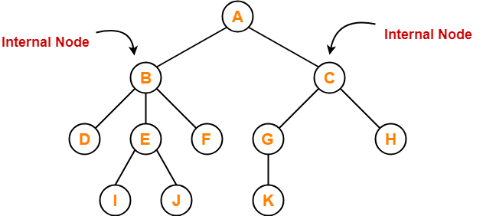
7. Internal Node
The node which has at least one child is called as an internal node.
Internal nodes are also called as non-terminal nodes.
Every non-leaf node is an internal node.

Slide 19
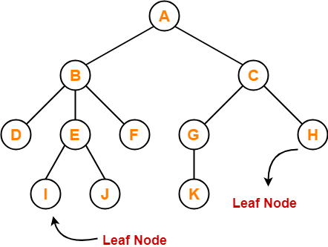
8. Leaf Node
The node which does not have any child is called as a leaf node.
Leaf nodes are also called as external nodes or terminal nodes.

Slide 20
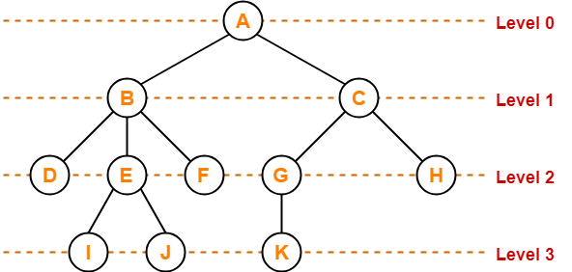
9. Level
In a tree, each step from top to bottom is called as level of a tree.
The level count starts with 0 and increments by 1 at each level or step.

Slide 21
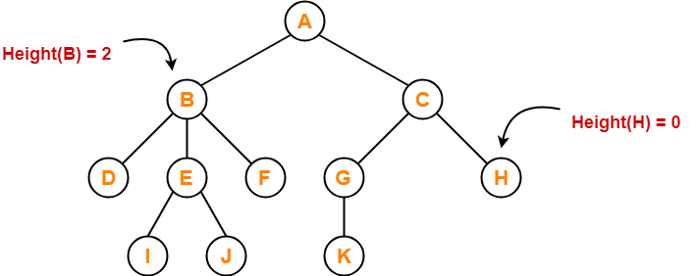
10. Height
Total number of edges that lies on the longest path from any leaf node to a particular node is called as height of that node.
Height of a tree is the height of root node.
Height of all leaf nodes = 0
Computed from bottom to top

Slide 22
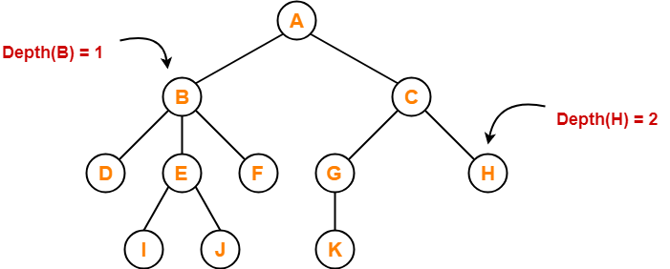
11. Depth
Total number of edges from root node to a particular node is called as depth of that node.
Depth of a tree is the total number of edges from root node to a leaf node in the longest path.
Depth of the root node = 0
The terms “level” and “depth” are used interchangeably.
Computed from top to bottom

Slide 23
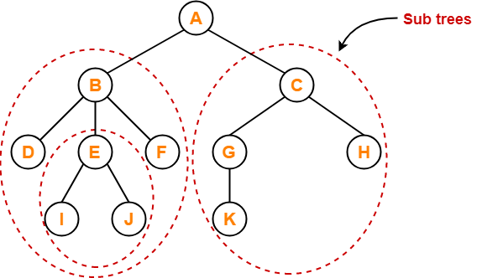
12. Subtree
In a tree, each child from a node forms a subtree recursively.
Every child node forms a subtree on its parent node.

Slide 24
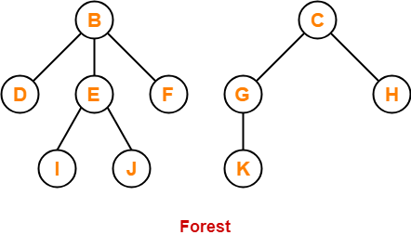
13. Forest
A forest is a set of disjoint trees.

Slide 25
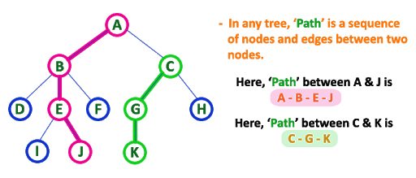
14. Path
• The sequence of consecutive edges from source node to destination node.

Slide 26
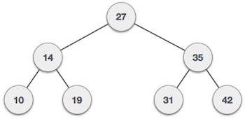
15. Keys
Key represents a value of a node based on which a search operation is to be carried out for a node.

Slide 27
Characteristics of trees
• Non-linear data structure
• Combines advantages of an ordered array and linked list
• Searching as fast as in ordered array
• Insertion and deletion as fast as in linked list
• Simple and fast

Slide 28
Application
• Directory structure of a file storage
• Structure of an arithmetic expressions
• Used in almost every 3D video game to determine what objects need to be rendered.
• Used in almost every high-bandwidth router for storing router-tables.
• used in compression algorithms, such as those used by the .jpeg and .mp3 file formats
Game trees

Slide 29
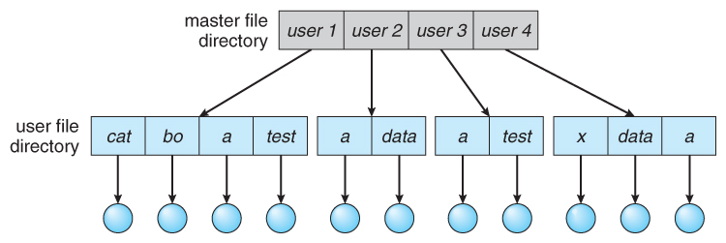
Directory structure of a file storage
Image courtesy: https://www.cs.uic.edu/~jbell/CourseNotes/OperatingSystems/images/Chapter11/11_10_TwoLevelStructure.jpg

Slide 30
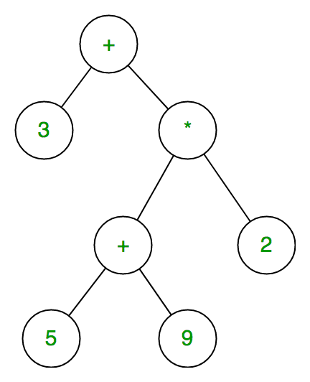
Structure of an arithmetic expressions
Image courtesy: https://media.geeksforgeeks.org/wp-content/uploads/expression-tree.png

Slide 31
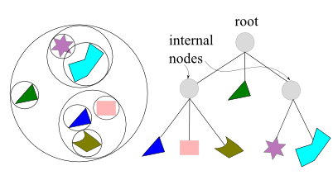
Object rendering in 3-D game
Image Courtesy: https://www.bogotobogo.com/Games/images/BVH.png

Slide 32
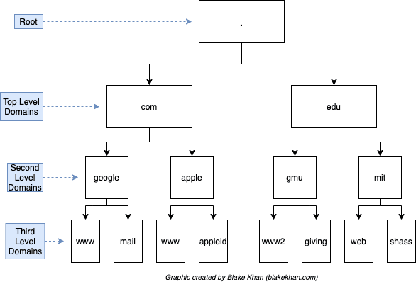
DNS Server entries
Image Courtesy: https://res.cloudinary.com/practicaldev/image/fetch/s--b9G6DenD--/c_limit%2Cf_auto%2Cfl_progressive%2Cq_auto%2Cw_880/https://i.imgur.com/xOdVIPZ.png

Slide 33
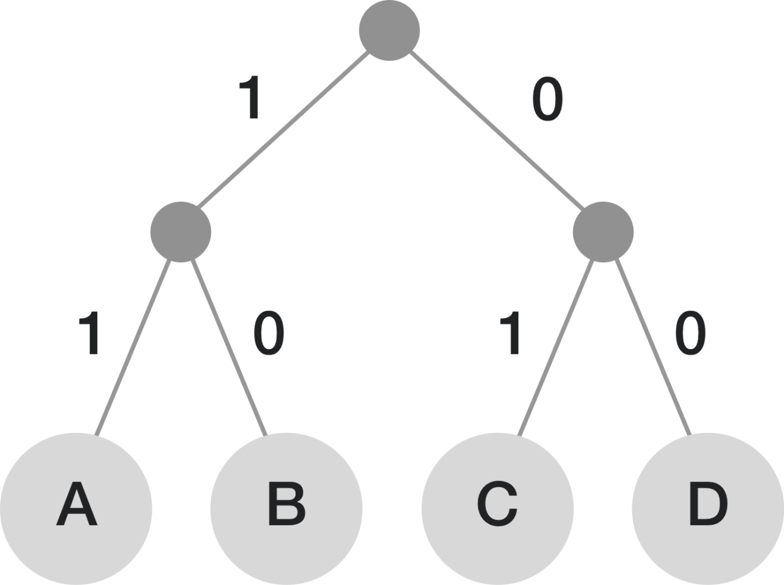
Compression Algorithm
https://brilliant-staff-media.s3-us-west-2.amazonaws.com/tiffany-wang/VEIWKBhSSc.png

Slide 34
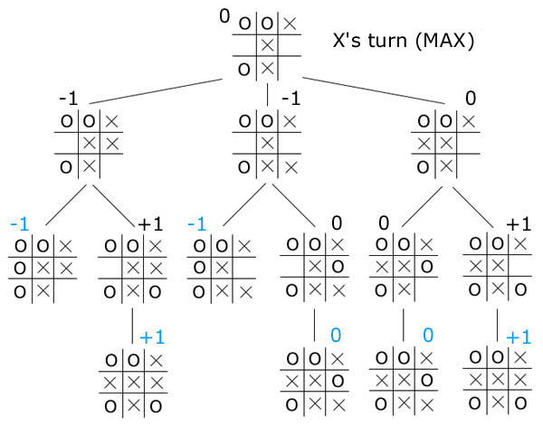
Game Tree
Image Courtesy: https://www.ocf.berkeley.edu/~yosenl/extras/alphabeta/alphabeta.jpg

Slide 35
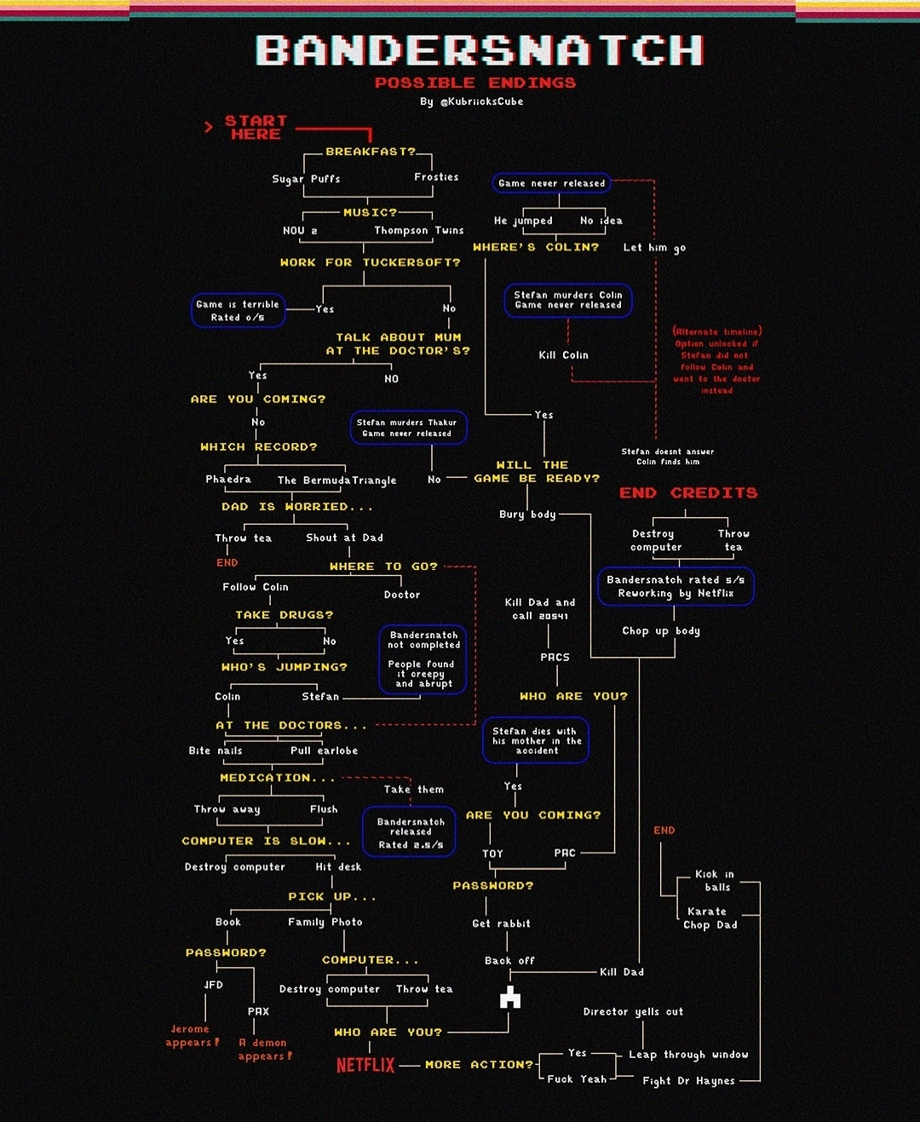
Bandersnatch
Notes:
I will add this in graph, it suits more there than in trees.

Slide 36
Binary Trees
A binary tree, T, is either empty or such that
T has a special node called the root node
T has two sets of nodes L_{T} and R_{T} , called the left subtree and right subtree of T, respectively.
L_{T} and R_{T} are binary trees.

Slide 37
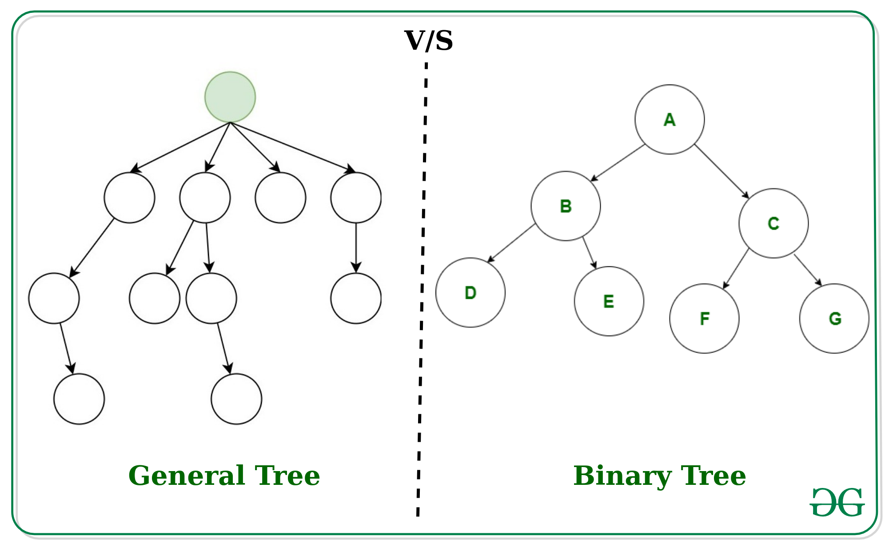

Slide 38
Binary Tree
A binary tree is a finite set of elements that are either empty or is partitioned into three disjoint subsets.
The first subset contains a single element called the root of the tree.
The other two subsets are themselves binary trees called the left and right sub-trees of the original tree.
A left or right sub-tree can be empty.
Each element of a binary tree is called a node of the tree

Slide 39
Binary Tree Properties
If a binary tree contains m nodes at level L, it contains at most 2^{m} nodes at level L+1
Since a binary tree can contain at most 1 node at level 0 (the root), it contains at most 2^{L} nodes at level L.

Slide 40
A
B
E
C
G
D
K
F
H
L
M
I
J

Slide 41
Samples of Trees
Complete Binary Tree
A
A
1
A
B
B
2
B
C
C
Skewed Binary Tree
3
D
E
F
G
D
4
H
I
E
5

Slide 42
Types of Binary Tree
Complete binary tree
Strictly binary tree
Almost complete binary tree

Slide 43
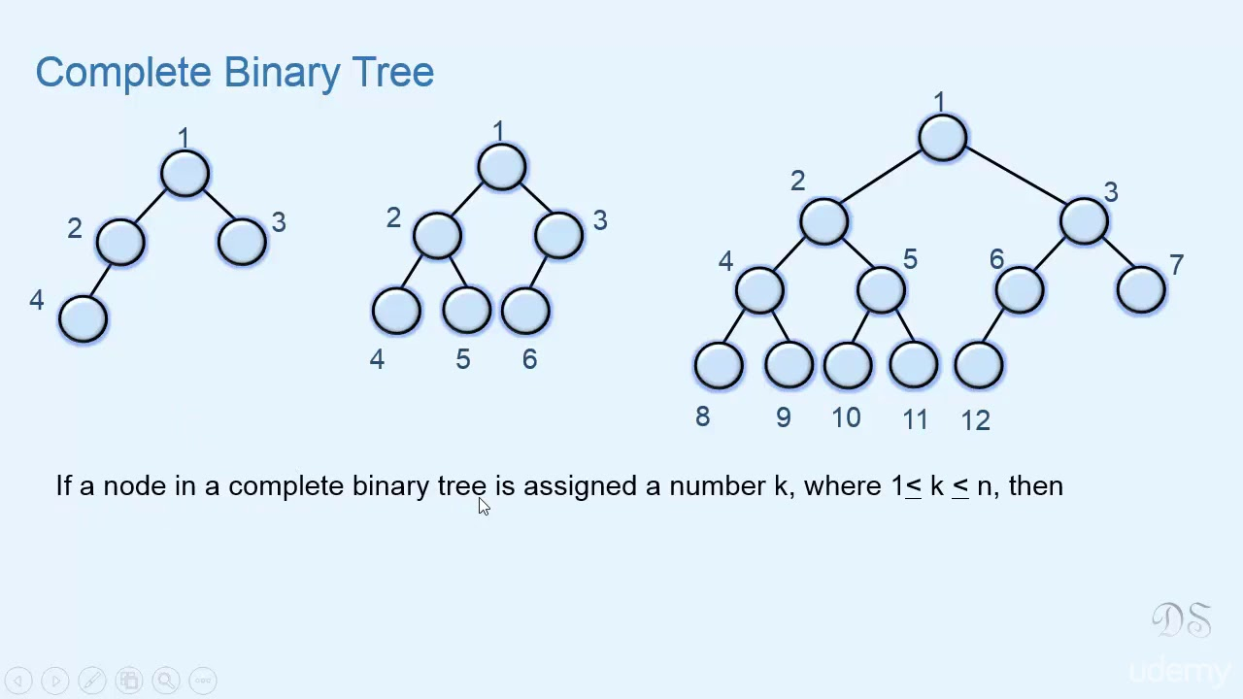
A complete binary tree

Slide 44
Binary tree types
Strictly binary trees are binary trees where every node either has two children or is a leaf (has no children).
Complete binary trees are strictly binary trees where every leaf is on the same "maximum" level.
Almost complete binary trees are not necessarily strictly binary (although they can be), and are not complete.

Slide 45
Full BT VS Complete BT
A full binary tree of depth k is a binary tree of depth k having 2 -1 nodes, k>=0.
A binary tree with n nodes and depth k is complete iff its nodes correspond to the nodes numbered from 1 to n in the full binary tree of depth k.
k
A
A
B
C
B
C
D
E
F
G
D
E
F
G
H
H
I
J
K
L
M
N
O
I
Complete binary tree
Full binary tree of depth 4

Slide 46
Sequential Representation
[1]
[2]
[3]
[4]
[5]
[6]
[7]
[8]
[9]
A
B
C
D
E
F
G
H
I
(1) waste space
(2) insertion/deletion
problem
A
[1]
[2]
[3]
[4]
[5]
[6]
[7]
[8]
[9]
.
[16]
A
B
--
C
--
--
--
D
--
.
E
B
A
C
B
C
D
D
E
F
G
E
H
I

Slide 47
Linked Representation
typedef struct node *tree_pointer;
typedef struct node {
int data;
tree_pointer left_child, right_child;
};
data
left_child
data
right_child
left_child
right_child

Slide 48
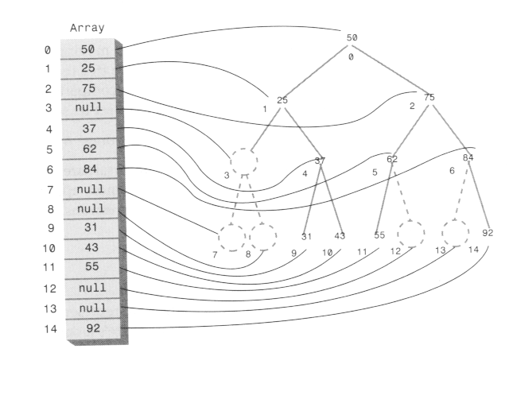
Array representaion of tree

Slide 49
Binary tree traversal
Traversal: visiting each node only once
Traversal methods:
Inorder : Left-Root-Right
Preorder : Root-Left-Right
Postorder : Left-Right-Root

Slide 50
Binary Tree Traversals
Let L, V, and R stand for moving left, visiting the node, and moving right.
There are six possible combinations of traversal
LVR, LRV, VLR, VRL, RVL, RLV
Adopt convention that we traverse left before right, only 3 traversals remain
LVR, LRV, VLR
inorder, postorder, preorder

Slide 51
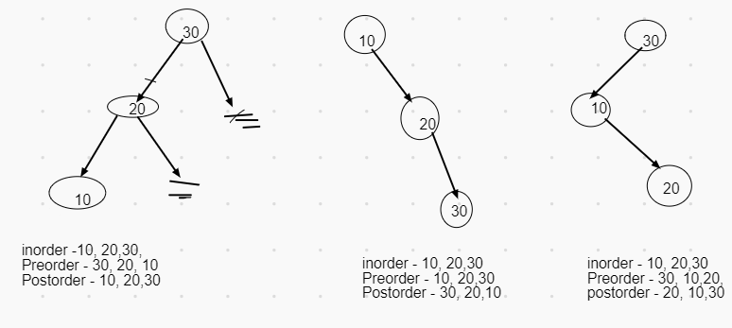
Binary Tree Traversals

Slide 52
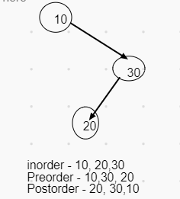
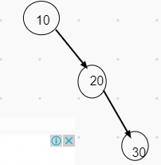
Binary Tree Traversals
Inorder - 10,20, 30
Preorder - 10,20,30
Postorder - 30, 20, 10

Slide 53
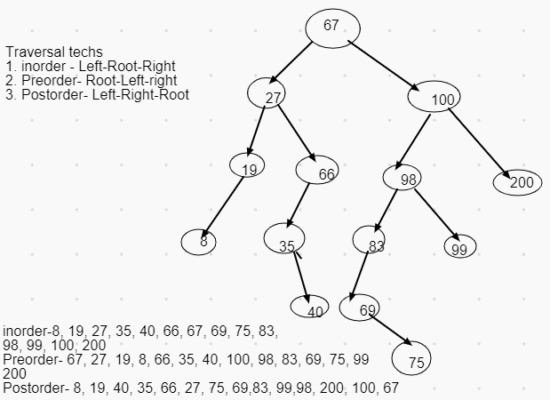
Binary Tree Traversals

Slide 54
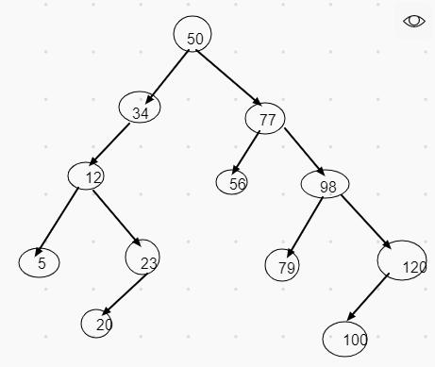
Binary Tree Traversals
Preorder- 50, 34, 12,5, 23, 20,77, 56,98 79,120, 100,
Postorder- 5, 20, 23, 12, 34, 56, 79, 100, 120, 98, 77, 50
Inorder- 5, 12, 20, 23, 34, 50, 56, 77,79, 98, 100, 120

Slide 55
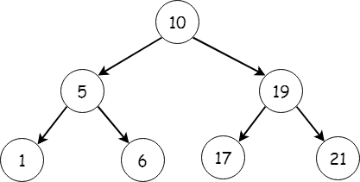
Binary tree Traversal
Inorder: 1-5-6-10-17-19-21
Preorder: 10-5-1-6-19-17-21
Postorder: 1-6-5-17-21-19-10

Slide 56
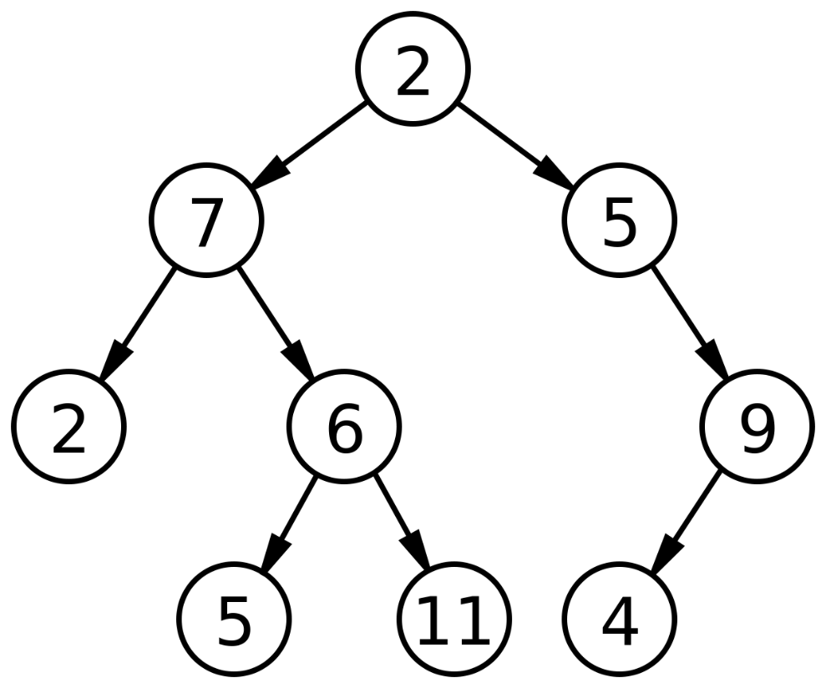
Binary tree Traversal
Inorder: ?
Preorder: ?
Postorder: ?

Slide 57
Arithmetic Expression Using BT
+
inorder traversal
A / B * C * D + E
infix expression
preorder traversal
+ * * / A B C D E
prefix expression
postorder traversal
A B / C * D * E +
postfix expression
level order traversal
+ * E * D / C A B
*
E
*
D
/
C
A
B

Slide 58
Inorder Traversal (recursive version)
void inorder(tree_pointer ptr)
/* inorder tree traversal */
{
if (ptr) {
inorder(ptr->left_child);
printf(“%d”, ptr->data);
indorder(ptr->right_child);
}
}
A / B * C * D + E

Slide 59
Preorder Traversal (recursive version)
void preorder(tree_pointer ptr)
/* preorder tree traversal */
{
if (ptr) {
printf(“%d”, ptr->data);
preorder(ptr->left_child);
predorder(ptr->right_child);
}
}
+ * * / A B C D E

Slide 60
Postorder Traversal (recursive version)
void postorder(tree_pointer ptr)
/* postorder tree traversal */
{
if (ptr) {
postorder(ptr->left_child);
postdorder(ptr->right_child);
printf(“%d”, ptr->data);
}
}
A B / C * D * E +

Slide 61
Construction of binary tree from traversals
Can be done with two pairs of information:
Inorder & Preorder
Inorder & Postorder
Inorder: 1-5-6-10-17-19-21
Preorder: 10-5-1-6-19-17-21

Slide 62
Binary Search Tree
Binary Search Tree is a node-based binary tree data structure which has the following properties:
The left subtree of a node contains only nodes with keys lesser than the node’s key.
The right subtree of a node contains only nodes with keys greater than the node’s key.
The left and right subtree each must also be a binary search tree.

Slide 63
Creation of Binary Search Tree from traversals
For inorder & Preorder traversal pairs:

Slide 64
Creation of Binary Search Tree from traversals
For inorder & Preorder traversal pairs:
Read the preorder input from left to right
Mark the corresponding nodes in inorder traversal to mark and left & right subtrees recursively
For inorder & Postorder traversal pairs:
Read the postorder input from right to left
Mark the corresponding nodes in inorder traversal to mark and right & left subtrees recursively

Slide 65
Creation of Binary Search Tree from traversals
Inorder: 1-5-6-10-17-19-21
Preorder: 10-5-1-6-19-17-21
Step 1: read preorder sequence from left to right, mark the corresponding node in inorder.
The preorder sequence gives roots and subroots while inorder sequence divides them in left and right part.

Slide 66
Creation of Binary Search Tree from traversals
Inorder: 1-5-6-10-17-19-21
Preorder: 10-5-1-6-19-17-21 (mark 5 as next root)
10
1,5,6
17,19,21
10
5
17,19,21
1
6

Slide 67
Creation of Binary Search Tree from traversals
Inorder: 1-5-6-10-17-19-21
Preorder: 10-5-1-6-19-17-21 (Mark 1 as next root, but it has no unmarked elements in inorder sequence i.e. it’s a leaf node)
10
5
17,19,21
1
6

Slide 68
Creation of Binary Search Tree from traversals
Inorder: 1-5-6-10-17-19-21
Preorder: 10-5-1-6-19-17-21 (Mark 6 as next root, but it has no unmarked elements in inorder sequence i.e. it’s a leaf node,too)
10
5
17,19,21
1
6

Slide 69
Creation of Binary Search Tree from traversals
Inorder: 1-5-6-10-17-19-21
Preorder: 10-5-1-6-19-17-21 (Mark 19 as next root)
10
5
19
1
6
17
21

Slide 70
Creation of Binary Search Tree from traversals
Inorder: 1-5-6-10-17-19-21
Preorder: 10-5-1-6-19-17-21 (Mark 17 as next root, it turns out to be a leaf node)
10
5
19
1
6
17
21

Slide 71
Creation of Binary Search Tree from traversals
Inorder: 1-5-6-10-17-19-21
Preorder: 10-5-1-6-19-17-21 (Mark 21 as next root, it turns out to be a leaf node,too)
10
5
19
1
6
17
21

Slide 72
Creation of Binary Search Tree from traversals
Follow same process for postorder and inorder sequence, but read the postorder from right to left.

Slide 73
Construction of Binary Search Tree
Construct a BST for:
10,45,23,90,21,65,100,4,78,50
50,78,4,100,65,21,90,23,45,10
65,4,50,10,78,45,100,23,90,21

Slide 74
Binary Search implementation
Struct tree{
int data;
struct tree *left;
struct tree *right;
}
Struct tree *t;

Slide 75
Insertion in BST
Treetype insert(TreeType *root, int key)
{ CreateNode(NewNode)
// find the position to insert the new node
Treetype *temp = root;
// Pointer parent maintains the trailing pointer of temp
Treetype *parent = NULL;
while (temp != NULL) {
parent = temp;
if (key < temp->data) temp = temp->left;
else temp = temp->right;
}
// If the root is NULL i.e the tree is empty The new node is the root node
if (parent == NULL) root = newnode;
// If the new key is less then the leaf node key Assign the new node to be its left child
else if (key < parent->data) parent->left = newnode;
// else assign the new node its right child
else parent->right = newnode;
return root;
}

Slide 76
Count nodes
int countNodes(TreeType t)
{
If (t==Null)
Print “tree is empty”
Else if (Left(t)==Null AND Right(t)==Null)
return 1
Else return(CountNodes(Left(t)+CountNodes(Right(t))+1
}

Slide 77
Binary Search tree deletion
Cases:
Deletion from empty tree
The key to be deleted doesn’t exist in tree
The node to be deleted is the only node in tree
The node to be deleted is root
The node to be deleted has
No child
Exactly one child
Two children

Slide 78
Deletion of a node in BST
//Deletion from empty tree
If (root==null)
{ print “Error”
exit
}
//Deletion of only node
If(root->data ==key && root->left==Null && root->right==Null)
{
temp=root
Root=null
Return(temp)
}

Slide 79
Parent = null
Temp =root
While(temp!=null && temp->data !=key)
{ if (key< temp->data)
parent = temp; temp=temp->left
else
parent = temp; temp=temp->right
}
If (temp==null)
Print “Error, element not found” Exit
Elseif (temp->left== null && temp->right==Null)
//node with no children
{ if (temp==parent->left)
parent->left= Null
Else
parent->right=Null
}

Slide 80
Elseif(temp->left!= null && temp->right==Null)
//node with only left child
{ if (temp==parent->left)
parent->left= temp->left
Else
parent->right=temp->left
}
Elseif(temp->left== null && temp->right!=Null)
//node with only right child
{ if (temp==parent->left)
parent->left= temp->right
Else
parent->right=temp->right
}

Slide 81
//Deletion of node with two children

Slide 82
AVL tree
Named after their inventors Adelson, Velski & Landis, AVL trees are height balancing binary search tree.

Slide 83
AVL tree
Let’s consider creation of a BST i.e. insert values starting from an empty tree
Insert values 1, 2, 3, 4, 5, 6, 7, 8, 9 into an empty BST
If inserted in given order, what is the tree?
Is inserting in the reverse order any better?

Slide 84
BST: Efficiency of Operations?
Problem:
Worst-case running time:
find, insert, delete
buildTree

Slide 85
How can we make a BST efficient?
Observation
Solution: Require a Balance Condition that
When we build the tree, make sure it’s balanced.
BUT…Balancing a tree only at build time is insufficient.
We also need to also keep the tree balanced as we perform operations.

Slide 86
Potential Balance Conditions
Left and right subtrees
Left and right subtrees

Slide 87
The AVL Tree Data Structure
An AVL tree is a self-balancing binary search tree.
Structural properties
Binary tree property (same as BST)
Order property (same as for BST)
Balance condition: balance of every node is between -1 and 1 where balance(node) = height(node.left) – height(node.right)

Slide 88
Example #1: Is this an AVL Tree?
Balance Condition: balance of every node is between -1 and 1 where balance(node) = height(node.left) – height(node.right)
6
4
8
1
7
11
10
12

Slide 89
Example #2: Is this an AVL Tree?
6
Balance Condition: balance of every node is between -1 and 1 where balance(node) = height(node.left) – height(node.right)
4
8
1
5
7
11
3
2

Slide 90
AVL Trees
3
10
2
2
5
20
0
1
1
0
2
9
15
30
0
0
7
17

Slide 91
First insert example
Insert(6)
Insert(3)
Insert(1)
Third insertion
What’s the only way to fix it?

Slide 92
Fix: Apply “Single Rotation”
AVL Property violated at node 6
6
3
3
1
6
1

Slide 93
Single rotation: The basic operation we’ll use to rebalance
Move child of unbalanced node into parent position
Parent becomes the “other” child (always okay in a BST!)
Other subtrees move in only way BST allows (we’ll see in generalized example)

Slide 94
Tree Rotations: Generalized

Slide 95
Generalizing our examples…
12
5
23
2
9
18
30
1
4
7
10

Slide 96
Generalizing our examples…
12
5
23
2
9
18
30
1
4
7
10

Slide 97
Generalizing our examples…
12
5
E
A
C

Slide 98
Generalizing our examples…
d
12
b
E
A
C

Slide 99
Generalized Single Rotation
d
b
E
A
C

Slide 100
Generalized Single Rotation
b
A
d
C
E

Slide 101
Single Rotations
(Figures by Melissa O’Neill, reprinted with her permission to Lilian)

Slide 102
Rotations
Insert 1,2,3
Right-Right or R-R case
Solution: rotate left

Slide 103
Insertion
First, insert the new key as a new leaf just as in ordinary binary search tree
Then trace the path from the new leaf towards the root. For each node x encountered, check if heights of left(x) and right(x) differ by at most 1.
If yes, proceed to parent(x). If not, restructure by doing either a single rotation or a double rotation
For insertion, once we perform a rotation at a node x, we won’t need to perform any rotation at any ancestor of x.

Slide 104
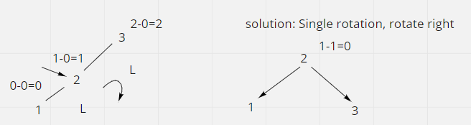
Rotations
Insert 3,2,1
Left-Left or L-L situation
Solution: Rotate right

Slide 105
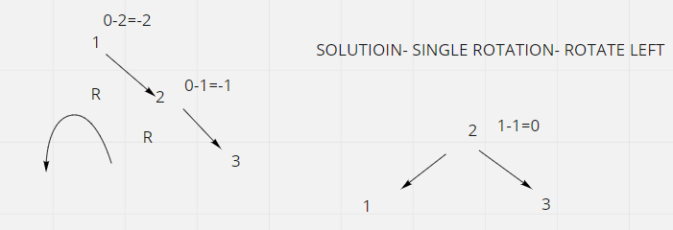
Rotations
Insert 1,2,3
Right-Right or R-Right situation
Solution: one rotation

Slide 106
Rotations
Insert 1,3,2
Right-Left or R-L situation
Solution: Two rotations
Rotate right ➔ R-R
Rotate left

Slide 107
Rotations
Insert 1,3,2
Right-Left or R-L situation
Solution: Two rotations
Rotate right➔ R-R
Rotate left

Slide 108
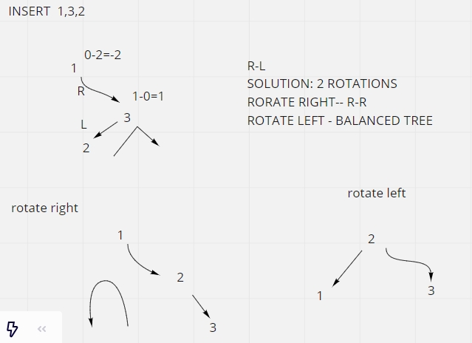

Slide 109
Rotations
Insert 3,1, 2
Left-Right or L-R situation
Solution: Two rotations
Rotate left➔ L-L
Rotate right

Slide 110
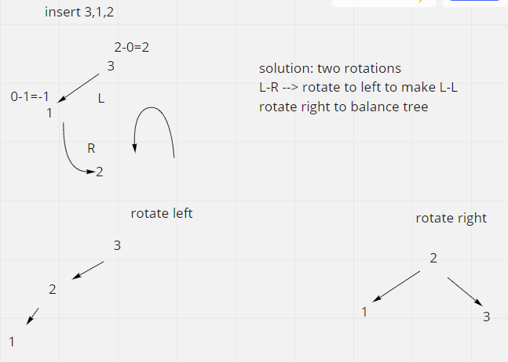

Slide 111
Rotation summary
L-L then single rotation --> rotate right
R-R then single rotation--> rotate left
L-R then double rotation --> rotate left to get L-L then rotate right
R-L then double rotation --> rotate right to get R-R then rotate left

Slide 112
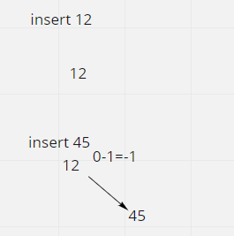
Example- 12, 45, 65, 23, 89, 50, 4, 35,100

Slide 113
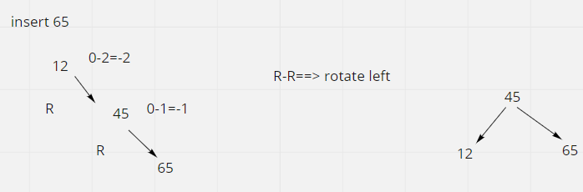

Slide 114
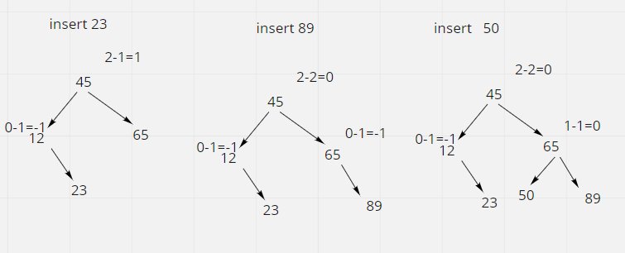

Slide 115


Slide 116


Slide 117


Slide 118

Create AVL tree:10, 20, 30, 25, 40, 50, 35, 33, 37, 60,38

Slide 119


Slide 120


Slide 121


Slide 122


Slide 123

Balance the tree

Slide 124

Example 3: 8,3,5,25,76, 45, 30,26,28,27

Slide 125


Slide 126


Slide 127


Slide 128


Slide 129


Slide 130
Case #1:
d
b
E
A
C
a’
(Figures by Melissa O’Neill, reprinted with her permission to Lilian)

Slide 131
Example #2 for left-left case: insert(16)
15
8
22
4
10
19
24
3
6
17
20
16

Slide 132
Case #2:
(Figures by Melissa O’Neill, reprinted with her permission to Lilian)

Slide 133
Example for right-right case: insert(26)
15
15
8
22
8
24
4
10
19
24
4
10
22
25
3
6
3
6
19
23
23
25
26
26

Slide 134
Case #3:
(Figures by Melissa O’Neill, reprinted with her permission to Lilian)

Slide 135
A Better Look at Case #3:
(Figures by Melissa O’Neill, reprinted with her permission to Lilian)

Slide 136
Case #3: Right-Left Case (after one rotation)
right rotate
A way to remember it:
Move d to grandparent’s position. Put everything else in their only legal positions for a BST.
(Figures by Melissa O’Neill, reprinted with her permission to Lilian)

Slide 137
Practice time! Example of Case #4
Starting with this AVL tree:
60
Which of the following is the updated AVL tree after inserting 42?
30
80
10
50
A)
B)
C)
D)
42
30
50
50
30
60
10
50
30
60
30
60
10
50
80
42
60
80
10
42
80
10
42
80

Slide 138
Pros and Cons of AVL Trees
Arguments for AVL trees:
All operations logarithmic worst-case because trees are always balanced
Height balancing adds no more than a constant factor to the speed of insert and delete
Arguments against AVL trees:
Difficult to program & debug [but done once in a library!]
More space for height field
Asymptotically faster but rebalancing takes a little time
If amortized logarithmic time is enough, use splay trees (also in the text, not covered in this class)

Slide 139
Queries?

Slide 140
Thank you!

